Slide 1

Movies Investment Proposal : 2017
for “IRA Productions”
by Prashant

Slide 2
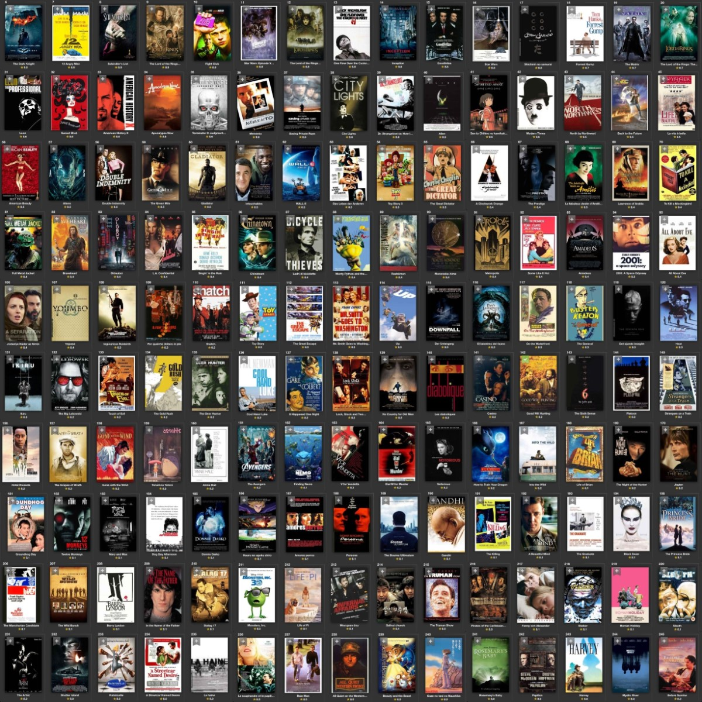
.
Movies (2006 -2016)
…

Slide 3
Movie Business Research Project 2017
One of My Client “IRA Productions” has recently entered into Area of Movie Production . They want to know how they can ensure success in future .

Slide 4
..
Data in Depth ….
IMDB (Internet Movie Database): Popular online database for movies, television programs etc.
IMDB Registered users: Rate movies on a scale of 1 to 10.
IMDB Rating: Weighted-Mean Rating displayed beside each movie title.
Metascore: IMDB displays rating from metacritic.com
IMDB Most Popular 1000 movies from 2006-2016

Slide 5
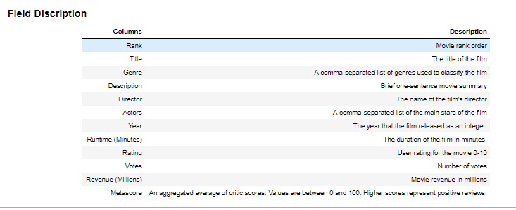
Data in Depth ..
Data in depth

Slide 6
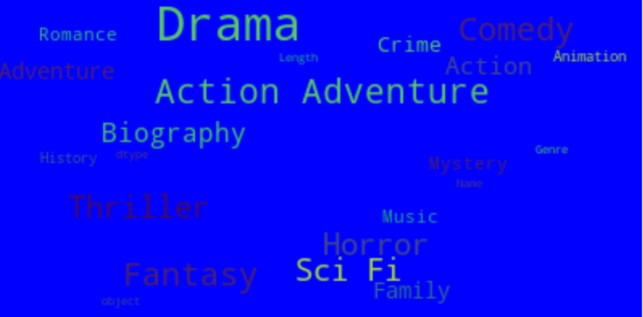
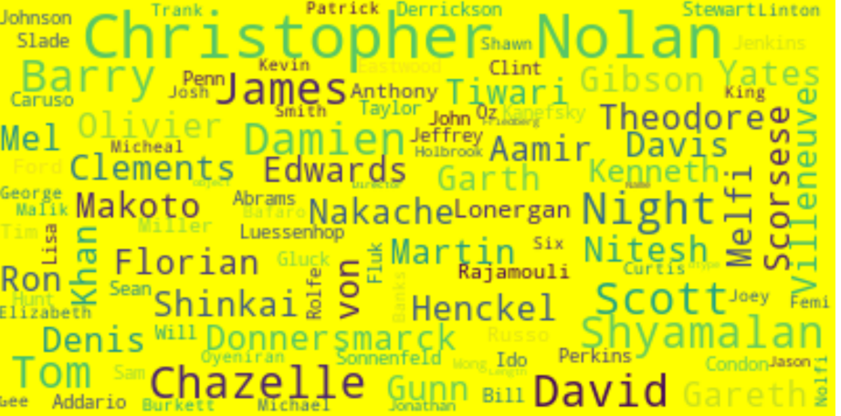
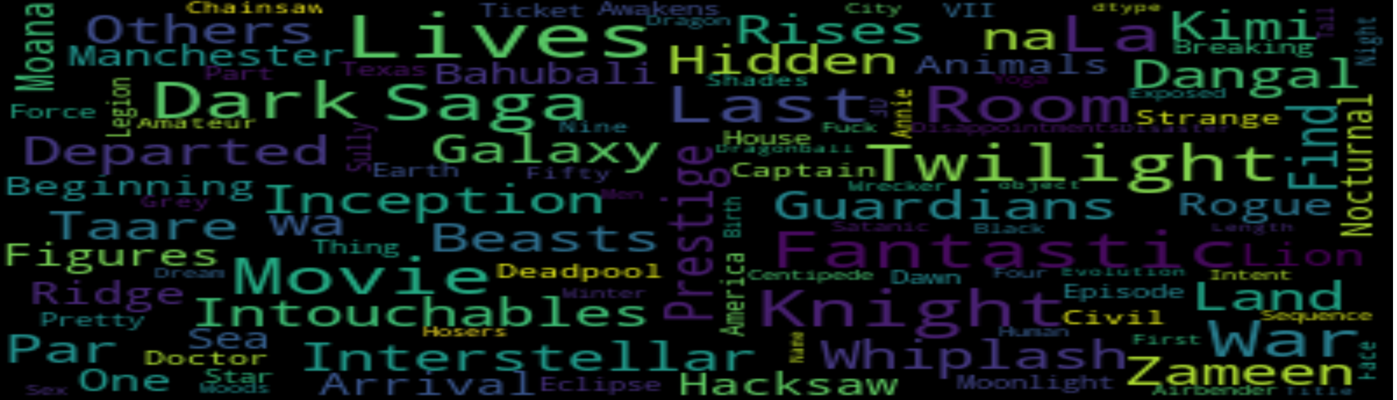
..
Data in Depth ….

Slide 7
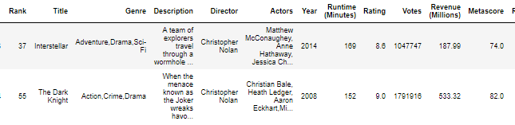
Data in Depth ..
Data consist of 1000 Movies
All Movies are Unique . There is no duplicate Data
There are NaN (Blank) Values for Metascore and Revenue Millions
Metascore has 64 / 6.4% missing values
Revenue (Millions) has 128 / 12.8% missing values
Genre Column has multiple genre for a single movie
Actors Column has multiple Actors for a single movie

Slide 8
Problem statement
One of the Investor "IRA Productions" approached me in 2017 to consult on the Ideas on Investing Money on Movies. They are not sure which type of movie they should make that may have higher chances of success and can become a super hit of 2017 .
To Understand the dynamics and trends of Entertainment /Film Industry around the world during 2006 to 2016.

Slide 9
What did I do ?
Replacing Missing Values for Metascore ,Revenue (Millions)
New Column Addition 'Rating_Class' based on Rating Column
New Column Addition 'Votes_Class' based on 'Votes' Column
New Column Addition "Film_Type" based on 'Runtime (Minutes)'
Processing on 'Genre' column
Processing on 'Actors' column

Slide 10
What did I do ?
Data Visualization done in Python and supported package to know the relationship between the different variables available in the movie data
Finally Arriving on Conclusion from each graph plotted
Suggesting Actionable Insights from the conclusions drawn

Slide 11
What did I do ?
Replacing Missing Values for Metascore ,Revenue (Millions) based on the median of Metascore ,,Revenue (Millions) based on correponding Ratings
#1) If Rating > '8.5' : Take all the record whose Rating >= 8.5 and Replace the Metascore with Median of Metascore and Replace the Revenue (Millions) with the Median Revenue (Millions)
#2) If Rating < '8.5' and Rating >= 7.5 : Take all the record whose Rating < 7.5 and Rating >= 6.5and Replace the Metascore with Median of Metascore and Replace the Revenue (Millions) with the Median Revenue (Millions)
#3) If Rating < '7.5' and Rating >= 6.5 : Take all the record whose Rating < 6.5 and Rating >= 5.5 and Replace the Metascore with Median of Metascore and Replace the Revenue (Millions) with the Median Revenue (Millions)
#4) If Rating < '6.5' and Rating >= 5.5 : Take all the record whose Rating < 5.5 and Rating >= 4.5' and Replace the Metascore with Median of Metascore and Replace the Revenue (Millions) with the Median Revenue (Millions)
#5) If Rating < '5.5' and Rating >= 4.5 : Take all the record whose Rating < 4.5 and Rating >= 3.5 and Replace the Metascore with Median of Metascore and Replace the Revenue (Millions) with the Median Revenue (Millions)
#6) If Rating < '4.5' and Rating >= 3.5 : Take all the record whose Rating < 3.5 and Rating >= 2.5 and Replace the Metascore with Median of Metascore and Replace the Revenue (Millions) with the Median Revenue (Millions)
#7) If Rating < '3.5' and Rating >= 2.5 : Take all the record whose Rating < 3.5 and Rating >= 2.5 and Replace the Metascore with Median of Metascore and Replace the Revenue (Millions) with the Median Revenue (Millions)
#8) If Rating < '2.5' : Take all the record whose Rating < 2.5 and Replace the Metascore with Median of Metascore and Replace the Revenue (Millions) with the Median Revenue (Millions)
.
.

Slide 12
What did I do ?
New Column Addition 'Rating_Class' based on Rating Column
Rating > 8.0 = Excellent
Rating > 6.0 = Great
Rating > 4.0 = Average
Rating < 4.0 = Poor
New Column Addition 'Votess_Class' based on 'Votes' Column
Votes > 1500000 = Very High
Votes >500000 = High
Votes > 100000 = Average
Votes > 50000 = Poor
Votes < 50000 = Very Poor

Slide 13
What did I do ?
New Column Addition "Film_Type" based on 'Runtime (Minutes)'
'Runtime (Minutes) > 150 = Very Long
'Runtime (Minutes) > 120 = Long
'Runtime (Minutes) > 90 = Average
'Runtime (Minutes) > 50 = Short
'Runtime (Minutes) < 50 = Very Short
Processing on 'Genre' column
Break the Genre Column and insert a new row with individual genre for the same movie
Processing on ‘Actors' column
Break the Actors Column and insert a new row with individual Actor for the same movie

Slide 14
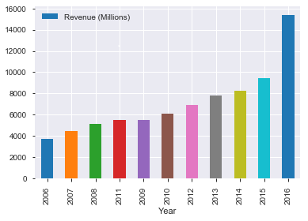
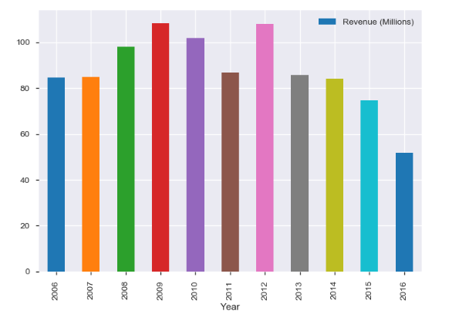
Movie Industry Growth (YR :2006-2016)
Total Revenues
Average Revenues
Conclusion :
From the chart we can see the Upward trend from 2006 -2016 . But Average Revenue start decreasing from 2013 onward due to more number of competitors. So we need to ensure that we produce Movies which can generate more votes and Rating from viewers and same-time revenue collection should be excellent.

Slide 15
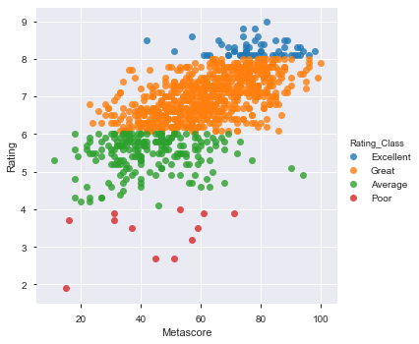
Relationship Between Rating and Metascore
Conclusion :
Movies which has Rating_Class = 'Excellent' and having High Metascore will best movies for inspiration while producing new movie Movies which falls under Rating_Class = 'Poor' should be completely avoided as there is high chance of failure and making losses

Slide 16
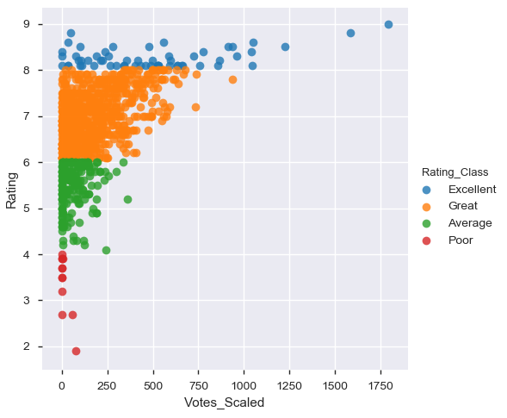
Relationship Between Rating and Votes
Conclusion :
# Movies which has Rating_Class = 'Excellent' and having Higher Votes will best movies for inspiration while producing new movie
# Movies which falls under Rating_Class = 'Poor' which received low vote should be completely avoided a there is high chance of failure

Slide 17
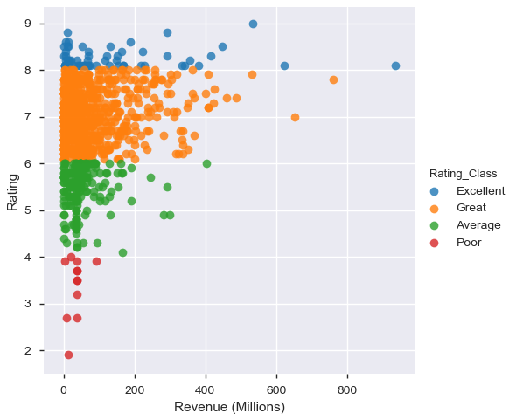
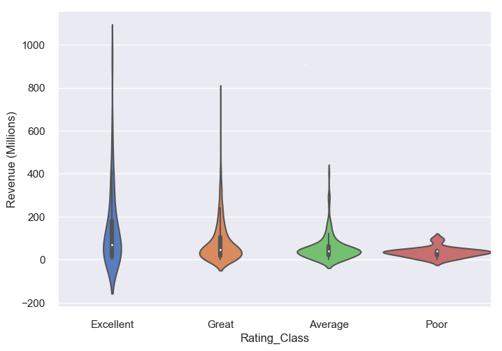
Relationship Between Rating and Revenue (Millions)
Conclusion :
#Movies which has Rating_Class = 'Excellent' and having Higher Revenues will best movies for inspiration while producing new movie
#Movies which falls under Rating_Class = 'Poor' which received low Revenues should be completed avoided a there is high chance of failure

Slide 18
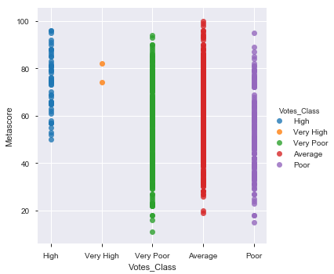
Relationship Between Metascore and Votes
Conclusion :
#Movies which has Votes_class in( ' Very High ',High ) and having Higher Metascore will best movies for inspiration while producing new movie
#Movies which falls under Votes_Class in ( 'Poor', 'Very Poor' ) and received Low Metascore should be completed avoided a there is high chance of failure

Slide 19
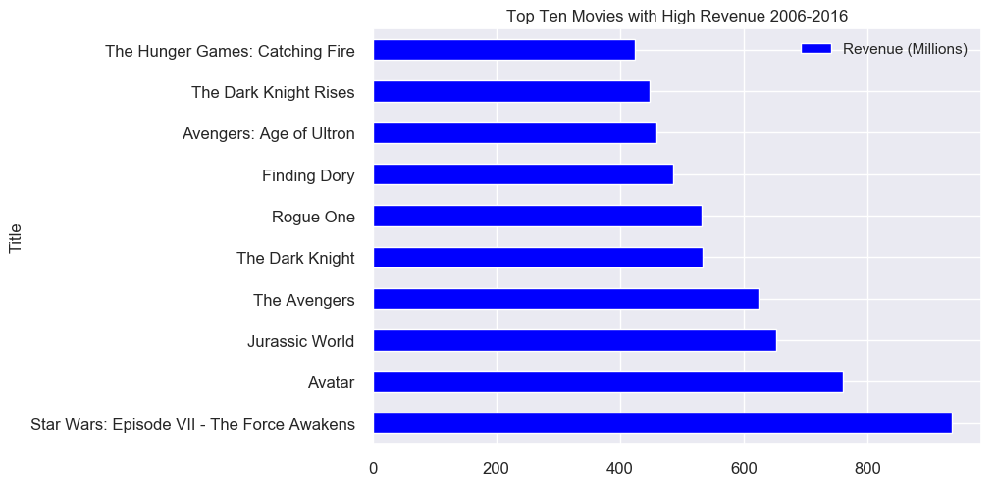
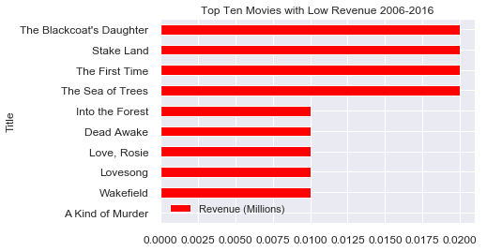
Top Ten Movies by High Revenue and Low Revenue
Conclusion :
Top five movies :Star wars Epiode VI , Avatar , Jurassic World ,The Avengers ,The Dark Night
Top five Flop movies :A King of Murder , Wakefield , Jurassic Lovesong ,Love Rosie ,The Dead Awake

Slide 20
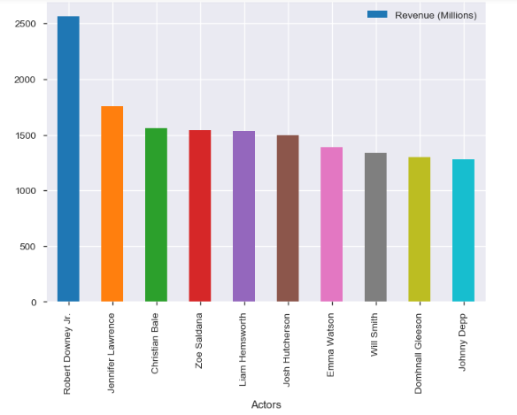
Top Ten Successful Actor/Actress
Conclusion :
Actor :
Robert Downey ,
Liam Hemsworth ,
Josh Hutcherson ,
Will Smith
Domhnall Gleeson
Johnny Depp
Actress :
Jennifer Lawrence ,
Christian Bale ,
Zoe Saldana ,
Emma Watson

Slide 21
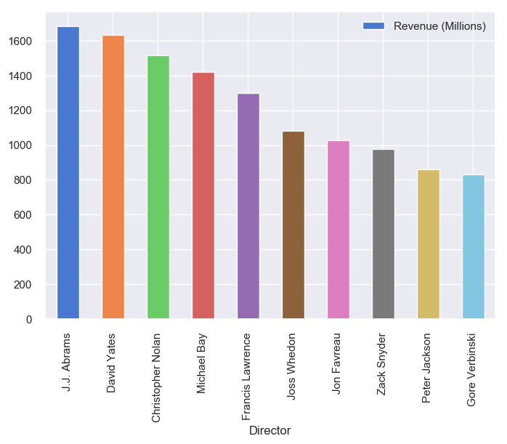
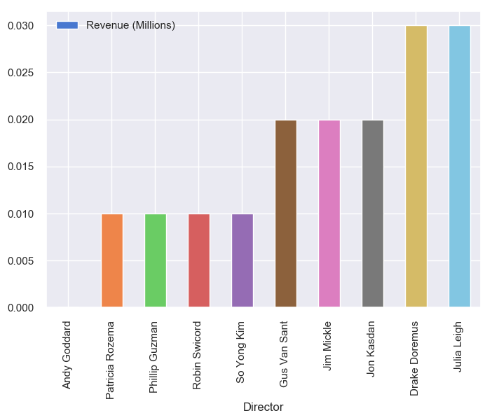
Top Ten Directors Based on Revenues
Top Ten
Bottom Ten

Slide 22
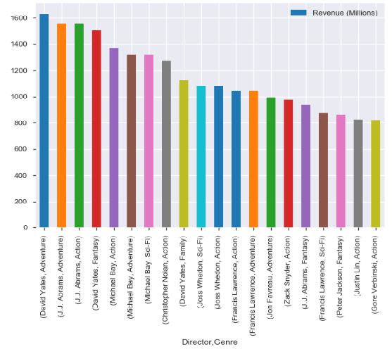
Top Ten Directors Based on Revenues/Genre

Slide 23
Top Ten Directors Based on Revenues/Genre
Top Five Director are :
David Yates ,
J. J. Abrams ,
Christopher Nolan ,
Michael Bay ,
Francis Lawrence
if we look Genre wise : Adventure ,Action : David Yates ,J.J. Abram
Fantasy : David Yates SCI-FI : Michael Bay
Overall J. J. Abrams Looks Best Director ,
Genre combination wise David Yates is Better Director

Slide 24
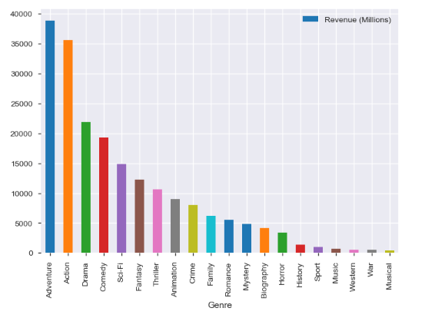
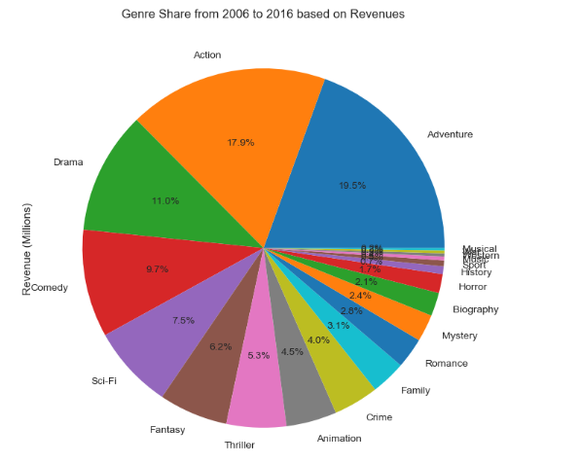
Top Ten Most Successful Genre

Slide 25
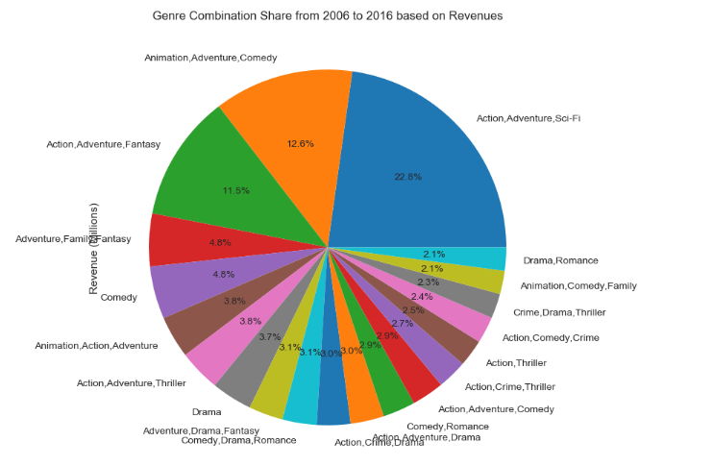
Genre Combination Share from 2006 to 2016 based on Revenues'

Slide 26
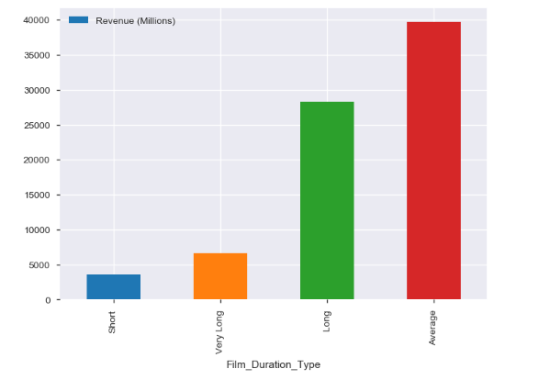
Relation Between Movie Duration and Revenues
Runtime (Minutes) >150 : Very Long
Runtime (Minutes) >120 : Long
Runtime (Minutes) > 90 : Average
Runtime (Minutes) < 90 : Short

Slide 27
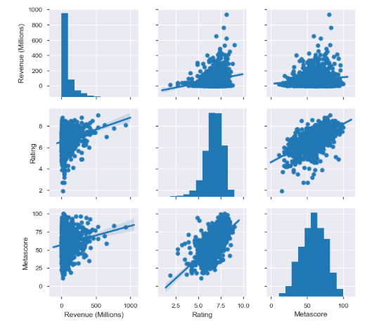
Correlation between Revenue, Rating and Metascore of Movies

Slide 28
Actionable Insights
1) 'Genre' of the Movie : Individual Genre : Action , Adventure ,Drama ,Comedy
Genre in Combination : 1) Action,Adventure,Sci-Fi
2) Animation,Adventure,Comedy
3)Action,Adventure,Fantasy
4)Adventure,Family,Fantasy
2) Ideal Runtime of the movie : Duration Type should be in( ' Long ',Average )
Runtime (Minutes) >150 : Very Long
Runtime (Minutes) >120 : Long
Runtime (Minutes) > 90 : Average
Runtime (Minutes) < 90 : Short

Slide 29
Actionable Insights
3) Directors to Choose for the Movie : David Yates ,J. J. Abrams , Christopher Nolan , Michael Bay , Francis Lawrence
if we go Genre wise : Adventure ,Action : David Yates ,J.J. Abram Fantasy : David Yates , SCI-FI : Michael Bay
4) Actor/Actress to choose for the Movie :
Actor : Robert Downey , Liam Hemsworth , Josh Hutcherson , Will Smith
Actress :Jennifer Lawrence , Christian Bale ,Zoe Saldana , Emma Watson
5) Average Revenue Expectation Based on Ratings :
if Rating > 8.5 received then revenue expected would be greater than 600 Millions .

Slide 30
THANKS…..
Prashant
mr_prash2003@yahoo.com

